Slide 1
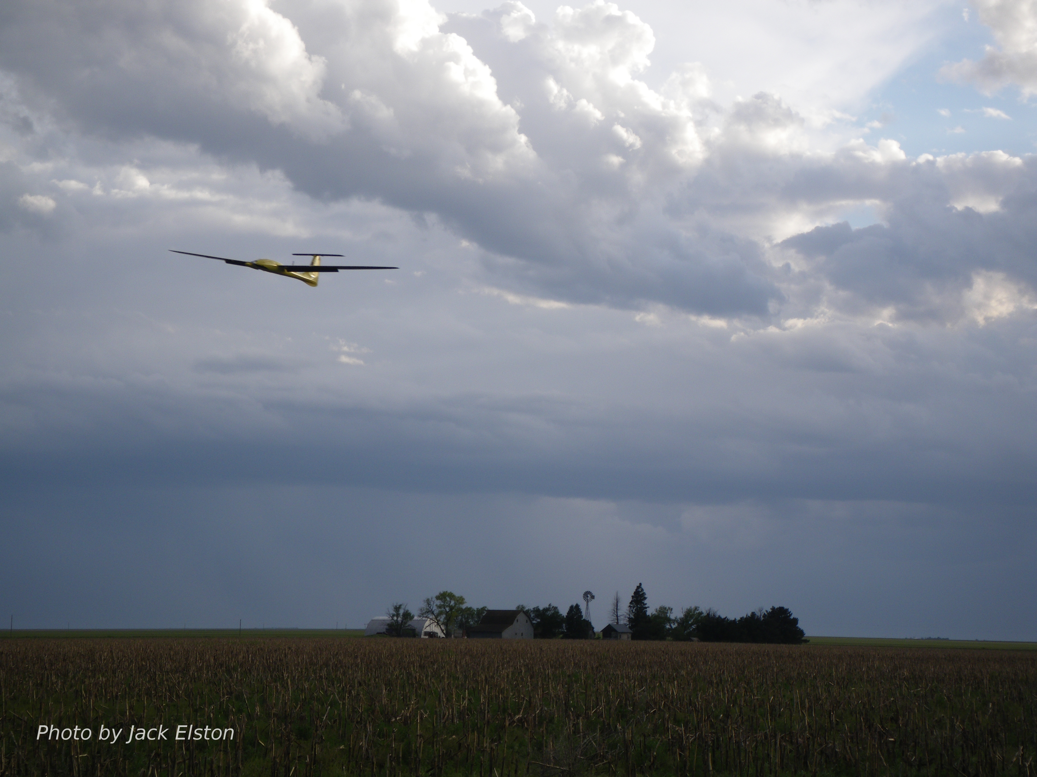
Chapter 5
Linear Design Models

Slide 2
Architecture

Slide 3
Equations of Motion
Notes:
%\begin{align}
\dot{p}_n &= (\cos\theta \cos\psi)u
+ (\sin\phi \sin\theta \cos\psi-\cos\phi \sin\psi)v
+ (\cos\phi \sin\theta \cos\psi+\sin\phi \sin\psi)w \\
\dot{p}_e &= (\cos\theta \sin\psi)u
+ (\sin\phi \sin\theta \sin\psi+\cos\phi \cos\psi)v
+ (\cos\phi \sin\theta \sin\psi-\sin\phi \cos\psi)w \\
\dot{h} &= u\sin\theta - v\sin\phi\cos\theta
-w\cos\phi\cos\theta \\
\dot{u} &= rv-qw - g\sin\theta
+ \frac{\rho V_a^2 S}{2\mass} \Big[
C_{X} (\alpha)
+ C_{X_{q}} (\alpha) \frac{c q}{2 V_a}
+ C_{X_{\delta_e}}(\alpha) \delta_e
\Big]
+ \frac{T_p(\delta_t, V_a)}{\mass} \\
\dot{v} &= pw-ru + g\cos\theta\sin\phi
+ \frac{\rho V_a^2 S}{2\mass}\Big[
C_{Y_0} + C_{Y_{\beta}} \beta
+ C_{Y_p} \frac{b p}{2V_a}
+ C_{Y_r} \frac{b r}{2V_a}
+ C_{Y_{\delta_a}} \delta_a + C_{Y_{\delta_r}} \delta_r
\Big] \\
\dot{w} &= qu-pv + g\cos\theta\cos\phi
+ \frac{\rho V_a^2 S}{2\mass} \Big[
C_{Z}(\alpha)
+ C_{Z_{q}}(\alpha) \frac{c q}{2 V_a}
+ C_{Z_{\delta_e}}(\alpha) \delta_e
\Big] \\
\dot{\phi} &= p + q\sin\phi\tan\theta + r\cos\phi\tan\theta \\
\dot{\theta} &= q\cos\phi - r\sin\phi \\
\dot{\psi} &= q\sin\phi\sec\theta + r\cos\phi\sec\theta \\
\dot{p} &= \Gamma_1 pq - \Gamma_2 qr
+ \frac{1}{2}\rho V_a^2 S b \Big[
C_{p_{0}}
+ C_{p_{\beta}} \beta
+ C_{p_p} \frac{b p}{2V_a}
+ C_{p_r} \frac{b r}{2V_a}
+ C_{p_{\delta_a}} \delta_a
+ C_{p_{\delta_r}} \delta_r
\Big] \\
\dot{q} &= \Gamma_5 pr - \Gamma_6(p^2-r^2)
+ \frac{\rho V_a^2 S c}{2J_y} \Big[
C_{m_{0}}
+ C_{m_{\alpha}} \alpha
+ C_{m_{q}} \frac{c q}{2 V_a}
+ C_{m_{\delta_e}} \delta_e
\Big] \\
\dot{r} &= \Gamma_7 pq - \Gamma_1 qr
+ \frac{1}{2}\rho V_a^2 S b \Big[
C_{r_{0}}
+ C_{r_{\beta}} \beta
+ C_{r_p} \frac{b p}{2V_a}
+ C_{r_r} \frac{b r}{2V_a}
+ C_{r_{\delta_a}} \delta_a
+ C_{r_{\delta_r}} \delta_r
\Big]

Slide 4
Equations of Motion

Slide 5
Lift and Drag Models
Notes:
\noindent Nonlinear model with stall effects
\begin{align*}
C_L(\alpha) &= \left(1-\sigma(\alpha)\right) \left[C_{L_0} + C_{L_{\alpha}}\alpha \right] + \sigma(\alpha) \left[2\;\text{sign}(\alpha)\sin^2\alpha\cos\alpha \right] \\
\sigma(\alpha) &= \frac{1+e^{-M(\alpha-\alpha_0)}+e^{M(\alpha+\alpha_0)}}{\left(1+e^{-M(\alpha-\alpha_0)}\right)\left(1+e^{M(\alpha+\alpha_0)}\right)} \\
C_{D}(\alpha) &= C_{D_p} + \frac{(C_{L_0} + C_{L_\alpha} \alpha)^2}{\pi e AR}
\end{align*}
\vspace{1cm}
\noindent Linear Model
\begin{align*}
C_L(\alpha) &= C_{L_0} + C_{L_{\alpha}}\alpha \\
C_D(\alpha) &= C_{D_0} + C_{D_{\alpha}}\alpha
\end{align*}

Slide 6
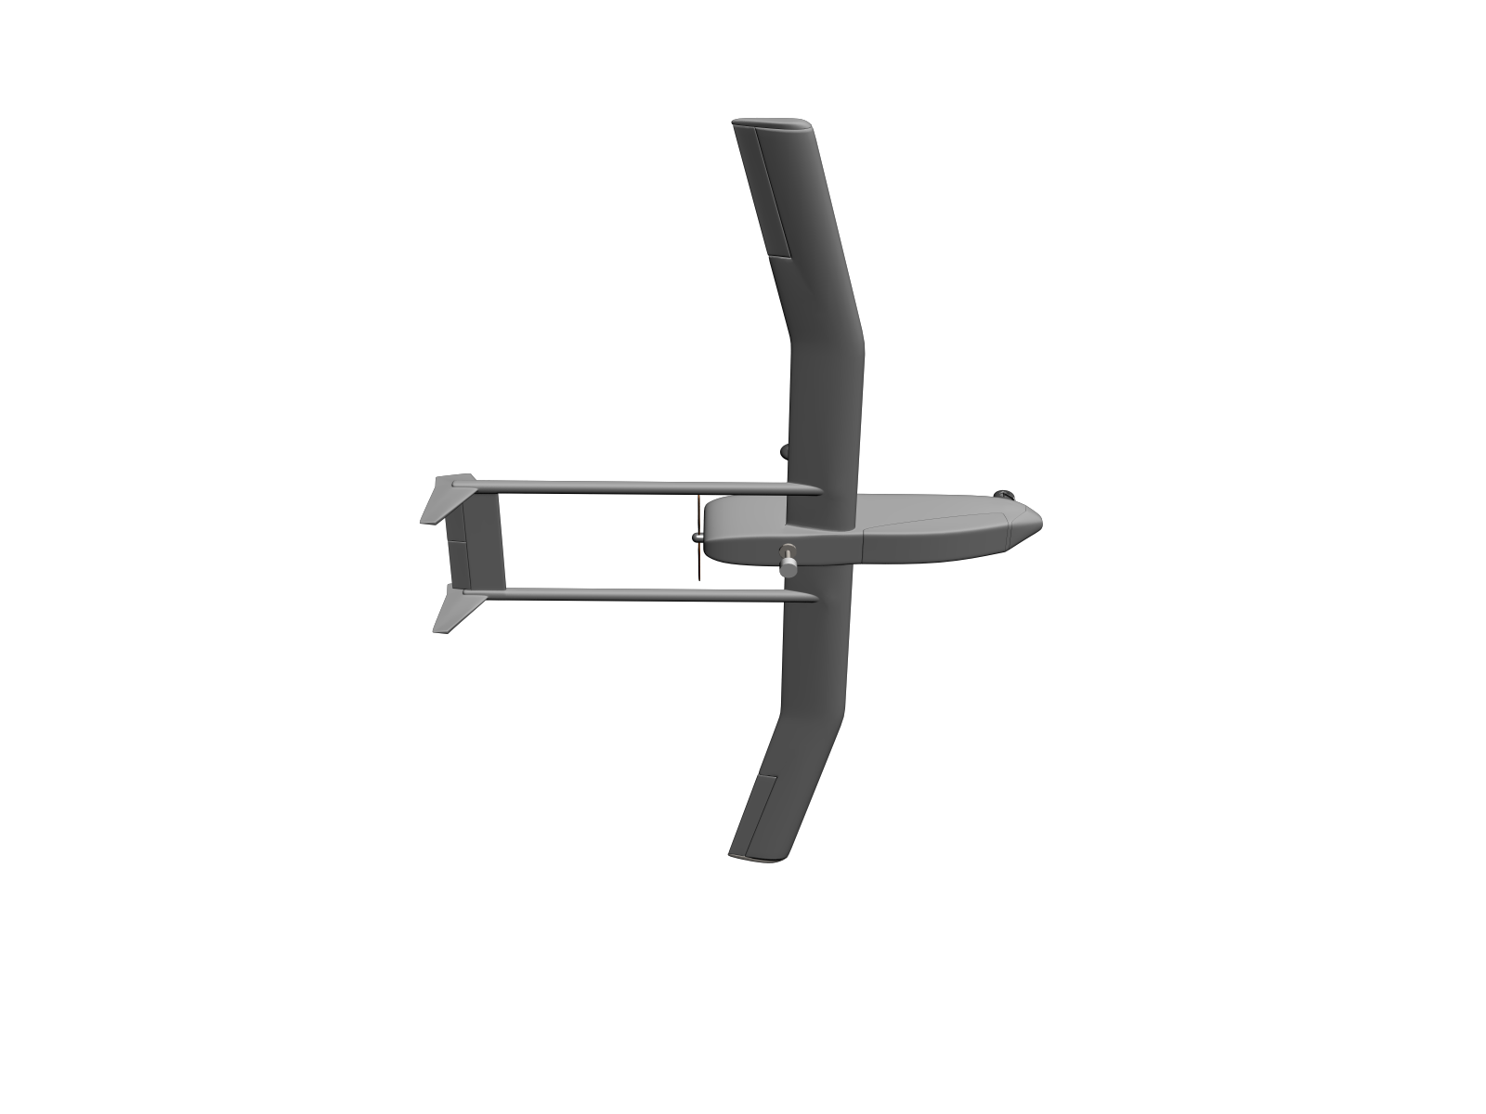
Coordinated Turn – No Wind
Notes:
F_{\text{lift}}\sin\phi &= \mass\frac{v^2}{R} \\
&= \mass v \omega \\
&= \mass V_a \dot{\psi}
----
F_{\text{lift}}\cos\phi = \mass g
----
\text{Dividing gives } \qquad \tan\phi &= \frac{V_a\dot{\psi}}{g}\\
\text{and } \qquad \quad \;\; \dot{\psi} &= \frac{g}{V_a}\tan\phi

Slide 7
Coordinated Turn
Notes:
F_{\text{lift}}\sin\phi\cos(\chi-\psi) &= \mathsf{m}\frac{v^2}{R} \\
&= \mathsf{m}v\omega \\
&= \mathsf{m}(V_g\cos\gamma)\dot{\chi}
F_{\text{lift}}\cos{\phi} = \mathsf{m}g\cos\gamma

Slide 8
Coordinated Turn
Notes:
\noindent Dividing the two expressions gives
\[
\dot{\chi} = \frac{g}{V_g}\tan\phi\cos(\chi-\psi)
\]
which is the coordinated turn condition in wind
\noindent In the absence of wind, we have $V_a=V_g$ and $\psi=\chi$ which gives
\[
\dot{\psi} = \frac{g}{V_a}\tan\phi
\]
which is the expression commonly seen in the literature
\noindent The turning radius is given by
\[
R = \frac{V_g\cos\gamma}{\dot{\chi}} = \frac{V_g^2\cos\gamma}{g\tan\phi\cos(\chi-\psi)}.
\]
\noindent For level flight in the absence of wind we have the standard formula
\[
R = \frac{V_a^2}{g\tan\phi}
\]

Slide 9
Trim Conditions
Notes:
\noindent Given the nonlinear system
\[
\dot{x} = f(x,u)
\]
The equilibria $(x^\ast, u^\ast)$ are defined by
\[
f(x^{\ast},u^{\ast}) = 0
\]
\vspace{1cm}
\noindent An aircraft in equilibrium is in a trim condition. In general, trim condition may
include states that are not constant. Therefore, trim conditions are given by
\[
\dot{x}^{\ast} = f(x^{\ast},u^{\ast})
\]

Slide 10
Calculating Trim
Notes:
\noindent Objective is to compute trim states
and inputs when aircraft simultaneously satisfies three conditions:
\begin{itemize}
\item Traveling at constant speed $V_a^{\ast}$
\item Climbing at constant flight path angle $\gamma^{\ast}$
\item In constant orbit of radius $R^{\ast}$
\end{itemize}
\vspace{0.5cm}
\noindent $V_a^{\ast}$, $\gamma^{\ast}$, and $R^{\ast}$, are inputs to the trim calculations
\vspace{0.5cm}
\begin{align*}
\text{States:} & \qquad x\defeq (p_n, p_e, p_d, u, v, w, \phi, \theta, \psi, p, q, r)^{\top} \\
\text{Inputs:} & \qquad u\defeq (\delta_e, \delta_a, \delta_r, \delta_t)^{\top}
\end{align*}

Slide 11
Calculating Trim
Notes:
\noindent \textbf{For constant-climb orbit:} \\
\noindent $\rightarrow$ speed of aircraft not changing $\rightarrow$ $\dot{u}^{\ast}=\dot{v}^{\ast}=\dot{w}^{\ast}=0$ \\
\noindent $\rightarrow$ roll and pitch angles constant $\rightarrow$ $\skew4\dot{\phi}^{\ast}=\skew4\dot{\theta}^{\ast}=\skew5\dot{p}^{\ast}=\dot{q}^{\ast}=0$ \\
\noindent Turn rate constant and given by
\begin{equation*}
\skew4\dot{\psi}^{\ast} = \frac{V_a^{\ast}}{R^{\ast}} \cos \gamma^{\ast} \quad \rightarrow \quad \dot{r}^{\ast}\,{=}\,0
\end{equation*}
\noindent Climb rate constant, and given by
\begin{equation*}
\skew4\dot{h}^{\ast} = V_a^{\ast} \sin\gamma^{\ast}
\end{equation*}
\vspace{.5cm}
\noindent Given parameters $V_a^{\ast}$, $\gamma^{\ast}$, and $R^{\ast}$, can specify $\dot{x}^{\ast}$ as\begin{equation*}\label{eq:linear-trim-xhatdot}
\dot{x}^{\ast} = (
\skew5\dot{p}_n^{\ast} \;\,
\skew5\dot{p}_e^{\ast} \;\,
\skew4\dot{h}^{\ast} \;\,
\dot{u}^{\ast} \;\,
\dot{v}^{\ast} \;\,
\dot{w}^{\ast} \;\,
\skew4\dot{\phi}^{\ast} \;\,
\skew4\dot{\theta}^{\ast} \;\,
\skew4\dot{\psi}^{\ast} \;\,
\skew5\dot{p}^{\ast} \;\,
\dot{q}^{\ast} \;\,
\dot{r}^{\ast} \;\,
)^{\top}
\end{equation*}
\vspace{.25cm}
\hspace{4.0cm}(continued…)

Slide 12
Calculating Trim
Notes:
\noindent Given parameters $V_a^{\ast}$, $\gamma^{\ast}$, and $R^{\ast}$, can specify $\dot{x}^{\ast}$ as\begin{equation*}\label{eq:linear-trim-xhatdot}
\dot{x}^{\ast} = \begin{pmatrix}
\skew5\dot{p}_n^{\ast} \\
\skew5\dot{p}_e^{\ast} \\
\skew4\dot{h}^{\ast} \\
\dot{u}^{\ast} \\
\dot{v}^{\ast} \\
\dot{w}^{\ast} \\
\skew4\dot{\phi}^{\ast} \\
\skew4\dot{\theta}^{\ast} \\
\skew4\dot{\psi}^{\ast} \\
\skew5\dot{p}^{\ast} \\
\dot{q}^{\ast} \\
\dot{r}^{\ast} \\
\end{pmatrix}
= \begin{pmatrix}
\text{[don't care]} \\
\text{[don't care]} \\
V_a^{\ast}\sin\gamma^{\ast} \\
0 \\
0 \\
0 \\
0 \\
0 \\
\frac{V_a^{\ast}}{R^{\ast}}\cos \gamma^{\ast} \\
0 \\
0 \\
0 \\
\end{pmatrix}
=f(x^\ast,u^\ast)
\end{equation*}
\noindent Problem of finding $x^{\ast}$ and $u^{\ast}$ such that $\dot{x}^{\ast}=f(x^{\ast},u^{\ast})$, reduces to solving nonlinear algebraic systems of equations.
\vspace{.25cm}
\noindent Can use Matlab trim command -- see Appendix F

Slide 13
Unconstrained Optimization

Slide 14
Unconstrained Optimization

Slide 15
Constrained Optimization

Slide 16
Equality Constraints

Slide 17
Inequality Constraints

Slide 18
Optimization in Python
from scipy.optimize import minimize
minimize(fun, # function to be minimized
x0, # initial guess for gradient descent
args=(), # additional arguments for fun
method=None, # optimization method
jac=None, # function that defines Jacobian of f
hess=None, # function that defines Hessian of f
hessp=None, # Hession in a specific direction
bounds=None, # inequality bounds on x
constraints=(), # definition of constraints
tol=None, # tolerance for termination
callback=None, # function called after each iteration
options=None) # other algorithm options

Slide 19
Example: Optimization in Python
from scipy.optimize import minimize
import numpy as np
def objective(x):
return(x[0]**2 + x[1]**2)
x0 = np.array([[5], [2]]) # initial condition
cons = ({'type': 'eq’,
'fun': lambda x: np.array([
x[0]+x[1]-2, # x1+x2=2
]),
})
res = minimize(objective, x0, method='SLSQP', constraints=cons)
print("xstar =", res.x)

Slide 20
Objective Function for Trim
def trim_objective_fun(x, mav, Va, gamma):
state = x[0:13]
delta = MsgDelta(elevator=x.item(13),
aileron=x.item(14),
rudder=x.item(15),
throttle=x.item(16))
desired_trim_state_dot
= np.array([[0., 0., -Va*np.sin(gamma), 0., 0., 0., 0., 0., 0., 0., 0., 0., 0.]]).T
mav._state = state
mav._update_velocity_data()
forces_moments = mav._forces_moments(delta)
f = mav._derivatives(state, forces_moments)
tmp = desired_trim_state_dot - f
J = np.linalg.norm(tmp[2:13])**2.0
return J

Slide 21
Constraints for Trim
cons = ({'type': 'eq’,
'fun': lambda x: np.array([
x[3]**2 + x[4]**2 + x[5]**2 - Va**2, # magnitude of velocity # vector is Va
x[4], # v=0, force side velocity to be zero
x[6]**2 + x[7]**2 + x[8]**2 + x[9]**2 - 1., # quaternion is unit length
x[7], # e1=0 - forcing e1=e3=0 ensures zero roll and zero yaw in trim
x[9], # e3=0
x[10], # p=0 - angular rates should all be zero
x[11], # q=0
x[12], # r=0
]),
'jac': lambda x: np.array([
[0., 0., 0., 2*x[3], 2*x[4], 2*x[5], 0., 0., 0., 0., 0., 0., 0., 0., 0., 0., 0.],
[0., 0., 0., 0., 1., 0., 0., 0., 0., 0., 0., 0., 0., 0., 0., 0., 0.],
[0., 0., 0., 0., 0., 0., 2*x[6], 2*x[7], 2*x[8], 2*x[9], 0., 0., 0., 0., 0., 0., 0.],
[0., 0., 0., 0., 0., 0., 0., 1., 0., 0., 0., 0., 0., 0., 0., 0., 0.],
[0., 0., 0., 0., 0., 0., 0., 0., 0., 1., 0., 0., 0., 0., 0., 0., 0.],
[0., 0., 0., 0., 0., 0., 0., 0., 0., 0., 1., 0., 0., 0., 0., 0., 0.],
[0., 0., 0., 0., 0., 0., 0., 0., 0., 0., 0., 1., 0., 0., 0., 0., 0.],
[0., 0., 0., 0., 0., 0., 0., 0., 0., 0., 0., 0., 1., 0., 0., 0., 0.],
])
})

Slide 22
Lateral Transfer Functions - Roll
Notes:
\noindent {\bf Objective:} Find simple transfer function relationship between $\phi$ and $\delta_a$
\vspace{.25cm}
\hspace{1.35cm} Start with: $\dot{\phi} = p + q\sin\phi\tan\theta + r\cos\phi\tan\theta$
\vspace{.25cm}
\noindent Assuming that $\theta$ is small and defining the linearization error (can be considered as a control disturbance) to be
$d_{\phi_1} \defeq q\sin\phi\tan\theta + r\cos\phi\tan\theta$ gives
\[
\dot{\phi} = p + d_{\phi_1}
\]
Differentiating and substituting for $\dot{\phi}$ gives
\begin{align*}
\ddot{\phi} &= \dot{p} + \dot{d}_{\phi_1} \\
&= \Gamma_1 pq - \Gamma_2 qr
+ \frac{1}{2}\rho V_a^2 S b \left[
C_{p_{0}}
+ C_{p_{\beta}} \beta
+ C_{p_p} \frac{b p}{2V_a}
+ C_{p_r} \frac{b r}{2V_a}
+ C_{p_{\delta_a}} \delta_a
+ C_{p_{\delta_r}} \delta_r
\right] + \dot{d}_{\phi_1} \\
&= \Gamma_1 pq - \Gamma_2 qr
+ \frac{1}{2}\rho V_a^2 S b \left[
C_{p_{0}}
+ C_{p_{\beta}} \beta
+ C_{p_p} \frac{b}{2V_a} (\dot{\phi}-d_{\phi_1})
+ C_{p_r} \frac{b r}{2V_a}
+ C_{p_{\delta_a}} \delta_a
+ C_{p_{\delta_r}} \delta_r
\right] + \dot{d}_{\phi_1} \\
&= \left(
\frac{1}{2}\rho V_a^2 S b C_{p_p} \frac{b}{2V_a}
\right) \dot{\phi}
+ \left( \frac{1}{2}\rho V_a^2 S b C_{p_{\delta_a}}
\right) \delta_a
+ \left\{
\Gamma_1 pq - \Gamma_2 qr
+ \frac{1}{2}\rho V_a^2 S b \left[
C_{p_{0}}
+ C_{p_{\beta}} \beta
- C_{p_p} \frac{b }{2V_a} (d_{\phi_1})
+ C_{p_r} \frac{b r}{2V_a}
+ C_{p_{\delta_r}} \delta_r
\right] + \dot{d}_{\phi_1} \right\} \\
&= -a_{\phi_1} \dot{\phi} + a_{\phi_2} \delta_a + d_{\phi_2}
\end{align*}

Slide 23
Equations of Motion
Notes:
Equations copied from slide 2

Slide 24
Roll Dynamics
Notes:
\noindent Linearization leads to second-order ordinary differential equation
\[
\ddot{\phi} = -a_{\phi_1} \dot{\phi} + a_{\phi_2} \delta_a + d_{\phi_2}
\]
\vspace{0.5cm}
\noindent
In transfer function form we have
\[
\phi(s) = \left( \frac{a_{\phi_2}}{s(s+a_{\phi_1})} \right) \left(
\delta_a(s) + \frac{1}{a_{\phi_2}} d_{\phi_2}(s) \right)
\]

Slide 25
Lateral Transfer Functions - Course
Notes:
\noindent
To derive transfer function from roll $\phi$ to course $\chi$,\\
start with no-wind coordinated turn condition
\[
\dot{\chi} = \frac{g}{V_g} \tan\phi
\]
Add and subtract $\frac{g}{V_g}\phi$ to get
\begin{align*}
\dot{\chi} &= \frac{g}{V_g} \phi + \frac{g}{V_g}\left(
\tan\phi - \phi\right) \\
&= \frac{g}{V_g} \phi + \frac{g}{V_g}d_{\chi}
\end{align*}
where $d_\chi = \tan\phi-\phi$ is an input disturbance
\vspace{0.25cm}
\noindent
The associated transfer function is
\[
\chi(s) = \frac{g/V_g}{s}\left( \phi(s) + d_{\chi}(s)\right)
\]

Slide 26
Lateral Transfer Functions - Sideslip
Notes:
\noindent
{\bf No-wind conditions:} \hspace{0.25cm} $v=V_a\sin\beta$
\vspace{0.1cm}
\noindent
{\bf Constant airspeed:} \hspace{0.25cm} $\dot{v} = (V_a\cos\beta)\dot{\beta}$
\vspace{0.25in}
\noindent
Substituting for $\dot{v}$ from the dynamics gives
\[
(V_a\cos\beta)\dot{\beta} = pw-ru + g\cos\theta\sin\phi
+ \frac{\rho V_a^2 S}{2\mass}\left[
C_{Y_0} + C_{Y_{\beta}} \beta + C_{Y_p} \frac{b p}{2V_a} + C_{Y_r} \frac{b
r}{2V_a} +
C_{Y_{\delta_a}} \delta_a + C_{Y_{\delta_r}} \delta_r
\right]
\]
Solving for $\dot{\beta}$ and grouping terms gives
\[
\dot{\beta} = -a_{\beta_1} \beta + a_{\beta_2} \delta_r + d_\beta
\]
where
\begin{align*}
a_{\beta_1} &= -\frac{\rho V_a S}{2\mass\cos\beta} C_{Y_{\beta}} \qquad \qquad
a_{\beta_2} = \frac{\rho V_a S}{2\mass\cos\beta}C_{Y_{\delta_r}} \\
d_{\beta} &= \frac{1}{V_a\cos\beta} (pw-ru + g\cos\theta\sin\phi) +\frac{\rho V_a S}{2\mass\cos\beta}\left[
C_{Y_0} + C_{Y_p} \frac{b p}{2V_a} + C_{Y_r} \frac{b r}{2V_a} + C_{Y_{\delta_a}} \delta_a
\right]
\end{align*}

Slide 27
Equations of Motion

Slide 28
Sideslip Dynamics
Notes:
\noindent
The differential equation
\[
\dot{\beta} = -a_{\beta_1} \beta + a_{\beta_2} \delta_r + d_\beta
\]
leads to the block diagram
----------
a_{\beta_1} &= -\frac{\rho V_a S}{2\mass} C_{Y_{\beta}} \\
a_{\beta_2} &= \frac{\rho V_a S}{2\mass}C_{Y_{\delta_r}} \\
d_{\beta} &= \frac{1}{V_a} (pw-ru + g\cos\theta\sin\phi)+\frac{\rho V_a S}{2\mass}\left[
C_{Y_0} + C_{Y_p} \frac{b p}{2V_a} + C_{Y_r} \frac{b r}{2V_a} + C_{Y_{\delta_a}} \delta_a
\right]

Slide 29
Longitudinal Transfer Functions - Pitch
Notes:
\noindent
To derive the transfer function from elevator to pitch angle
\begin{align*}
\dot{\theta} &= q\cos\phi - r\sin\phi \\
&= q + q(\cos\phi-1) - r\sin\phi \\
&\defeq q + d_{\theta_1}
\end{align*}
Differentiating and substituting $\dot{q}$ from the dynamics gives
\begin{align*}
\ddot{\theta} &=
\Gamma_6(r^2-p^2) +
\Gamma_5 pr
+ \frac{\rho V_a^2 c S}{2J_y}\left[
C_{m_{0}}
+ C_{m_{\alpha}} \alpha
+ C_{m_{q}} \frac{c q}{2 V_a}
+ C_{m_{\delta_e}} \delta_e
\right] + \dot{d}_{\theta_1} \\
&=
\Gamma_6(r^2-p^2) +
\Gamma_5 pr
+ \frac{\rho V_a^2 c S}{2J_y}\left[
C_{m_{0}}
+ C_{m_{\alpha}} (\theta-\gamma)
+ C_{m_{q}} \frac{c}{2 V_a} (\dot{\theta}-d_{\theta
1})
+ C_{m_{\delta_e}} \delta_e
\right] + \dot{d}_{\theta_1} \\
&= \left(\frac{\rho V_a^2 c S}{2J_y} C_{m_{q}}
\frac{c}{2 V_a} \right) \dot{\theta}
+ \left(\frac{\rho V_a^2 c S }{2J_y} C_{m_{\alpha}} \right) \theta
+ \left(\frac{\rho V_a^2 c S }{2J_y} C_{m_{\delta_e}} \right) \delta_e
+ \left\{ \Gamma_6(r^2-p^2) \right. \\
&\qquad \left. +
\Gamma_5 pr
+ \frac{\rho V_a^2 c S }{J_y} \left[
C_{m_{0}}
- C_{m_{\alpha}} \gamma
- C_{m_{q}} \frac{c}{2 V_a} d_{\theta_1}
\right] + \dot{d}_{\theta_1} \right\} \\
&=
-a_{\theta_1} \dot{\theta} - a_{\theta_2} \theta + a_{\theta_3} \delta_e +
d_{\theta_2}
\end{align*}

Slide 30
Equations of Motion

Slide 31
Longitudinal Transfer Functions - Pitch

Slide 32
Longitudinal TF - Altitude from Pitch
Notes:
\noindent To derive the transfer function from pitch to altitude (assuming constant airspeed)
\begin{align*}
\dot{h} &= u\sin\theta - v\sin\phi\cos\theta - w\cos\phi\cos\theta
\notag \\
&= V_a\theta + (u\sin\theta - V_a\theta) - v\sin\phi\cos\theta -
w\cos\phi\cos\theta
\notag \\
&= V_a\theta + d_h
\end{align*}
where
\[
d_h \defeq (u\sin\theta - V_a\theta) - v\sin\phi\cos\theta -
w\cos\phi\cos\theta
\]
The associated transfer function is
\[
h(s) = \frac{V_a}{s}\left(\theta + \frac{1}{V_a} d_h\right)
\]

Slide 33
Equations of Motion

Slide 34
Longitudinal Transfer Functions - Airspeed
Notes:
\newcommand{\mass}{\mathsf{m}}
\noindent Both pitch angle and throttle strongly affect airspeed. We wish to derive the relationship.
\vspace{.25cm}
\noindent If there is no wind, then
\[
V_a = \sqrt{u^2 + v^2 + w^2}.
\]
Differentiating gives
\[
\dot{V}_{a} = \dot{u}\cos\alpha\cos\beta +
\dot{v}\sin\beta + \dot{w}\sin\alpha\cos\beta
= \dot{u}\cos\alpha + \dot{w}\sin\alpha + d_{V_1}
\]
where
\[
d_{V_1} = -\dot{u}(1-\cos\beta)\cos\alpha -
\dot{w}(1-\cos\beta)\sin\alpha + \dot{v}\sin\beta.
\]
Substituting from the dynamics gives
\begin{align*}
\dot{V}_{a} &= r V_a\cos\alpha\sin\beta - p V_a\sin\alpha\sin\beta -g\cos\alpha\sin\theta +
g\sin\alpha\cos\theta\cos\phi \notag\\&\quad +\frac{\rho V_a^2 S}{2\mass} \left[ -C_{D}(\alpha) - C_{D_{\alpha}} \alpha -
C_{D_q}\frac{cq}{2 V_a} - C_{D_{\delta_e}}\delta_e \right]
+ \frac{1}{\mass}T_p(\delta_t, V_a)
+ d_{V_1}
\notag\\
&= \left(r V_a\cos\alpha - p V_a\sin\alpha\right)\sin\beta
-g\sin(\theta-\alpha) -
g\sin\alpha\cos\theta(1-\cos\phi)
\notag\\
&\quad +\frac{\rho V_a^2 S}{2\mass} \left[ -C_{D_0} - C_{D_{\alpha}} \alpha -
C_{D_q}\frac{cq}{2 V_a} - C_{D_{\delta_e}}\delta_e \right]
+ \frac{1}{\mass}T_p(\delta_t, V_a)
+ d_{V_1}
\notag\\
&= -g\sin\gamma +\frac{\rho V_a^2 S}{2\mass} \left[ -C_{D_0} -
C_{D_{\alpha}} \alpha - C_{D_q}\frac{cq}{2 V_a} -
C_{D_{\delta_e}}\delta_e \right] + \frac{1}{\mass}T_p(\delta_t, V_a)
+ d_{V_2}
\end{align*}

Slide 35
Longitudinal Transfer Functions - Airspeed
Notes:
\[
\dot{V_a} = -g\sin\gamma +\frac{\rho V_a^2 S}{2\mass} \left[ -C_{D_0} -
C_{D_{\alpha}} \alpha - C_{D_q}\frac{cq}{2 V_a} -
C_{D_{\delta_e}}\delta_e \right] + \frac{1}{\mass}T_p(\delta_t, V_a)
+ d_{V_2}
\]
\noindent Since this equation is nonlinear in $V_a$, we will linearize about trim: $\alpha^\ast$, $V_a^\ast$, $\theta^\ast$, $\delta_e^\ast$, $\delta_t^\ast$, and let
\[
\bar{V}_a = V_a-V_a^\ast, \qquad \bar{\theta} = \theta-\theta^\ast, \qquad \bar{\delta}_e = \delta_e-\delta_e^\ast, \qquad \bar{\delta}_t = \delta_e-\delta_t^\ast
\]
to get
\begin{align*}
\dot{\bar{V}}_a &= -
g\cos(\theta^{\ast}-\alpha^{\ast}) \bar{\theta} + \left\{
\frac{\rho V^{\ast}_a S}{\mass} \left[-C_{D_0} - C_{D_{\alpha}}
\alpha^{\ast} - C_{D_{\delta_e}}\delta^{\ast}_e\right] + \frac{1}{\mass}
\frac{\partial T_p}{\partial V_a}(\delta_t^\ast, V_a^\ast) \right\} \bar{V}_a
%\notag\\ & \qquad \qquad
+ \frac{1}{\mass}\frac{\partial T_p}{\partial \delta_t}(\delta_t^\ast, V_a^\ast)
\bar{\delta}_t + d_V \notag\\
&= - a_{V_1} \bar{V}_a + a_{V_2}\bar{\delta}_t - a_{V_3}\bar{\theta} + d_V
\end{align*}
where
\begin{align*}
a_{V_1} &= \frac{\rho V^{\ast}_a S}{\mass} \left[C_{D_0} +
C_{D_{\alpha}} \alpha^{\ast} + C_{D_{\delta_e}}\delta^{\ast}_e\right]
- \frac{1}{\mass}\frac{\partial T_p}{\partial V_a}(\delta_t^\ast, V_a^\ast) \\
a_{V_2} &= \frac{1}{\mass}\frac{\partial T_p}{\partial \delta_t}(\delta_t^\ast, V_a^\ast) \\
a_{V_3} &= g\cos(\theta^\ast-\alpha^\ast) \\
\end{align*}

Slide 36
Longitudinal Transfer Functions - Airspeed
Key inputs are pitch angle
and throttle command
Notes:
\noindent The associated transfer function is
\[
\bar{V}_a(s) = \frac{1}{s+a_{V_1}}\left(a_{V_2}\bar{\delta}_t(s)
- a_{V_3}\bar{\theta}(s) + d_V(s) \right)
\]
\vspace{.5cm}
\noindent For throttle we have
\[
V_a(s) = \frac{a_{V_2}}{s+a_{V_1}}\left(\delta_t(s)
+ d_{V}(s) \right)
\]
and for pitch angle we have
\[
V_a(s) = \frac{-a_{V_3}}{s+a_{V_1}}\left(
\theta(s) + d_{V}(s) \right)
\]

Slide 37
Linear State-space Models

Slide 38
Lateral State-space Equations
Notes:
\noindent The lateral states and inputs are defined as
\[
\dot{x}_{\text{lat}} \defeq (v,p,r,\phi,\psi)^{\top}
\qquad
u_{\text{lat}} \defeq (\delta_a,\delta_r)^{\top}
\]
The nonlinear equations of motion are
\begin{align*}
\dot{v} &= pw-ru + g\cos\theta\sin\phi
+ \frac{\rho \sqrt{u^2+v^2+w^2} S}{2\mass} \frac{b}{2} \Big[
C_{Y_p} p
+ C_{Y_r} r
\Big]
\notag \\ & \qquad \qquad
+ \frac{\rho (u^2+v^2+w^2) S}{2\mass}\Big[
C_{Y_0}
+ C_{Y_{\beta}} \tan^{-1}\left(\frac{v}{\sqrt{u^2+w^2}}\right)
+ C_{Y_{\delta_a}} \delta_a
+ C_{Y_{\delta_r}} \delta_r
\Big] \\
\dot{p} &= \Gamma_1 pq - \Gamma_2 qr
+ \frac{\rho \sqrt{u^2+v^2+w^2} S}{2} \frac{b^2}{2} \Big[
C_{p_p} p
+ C_{p_r} r
\Big]
\notag \\ & \qquad \qquad
+ \frac{1}{2}\rho (u^2+v^2+w^2) S b \Big[
C_{p_{0}}
+ C_{p_{\beta}} \tan^{-1}\left(\frac{v}{\sqrt{u^2+w^2}}\right)
+ C_{p_{\delta_a}} \delta_a
+ C_{p_{\delta_r}} \delta_r
\Big] \\
\dot{r} &= \Gamma_7 pq - \Gamma_1 qr
+ \frac{\rho \sqrt{u^2+v^2+w^2} S}{2} \frac{b^2}{2} \Big[
C_{r_p} p
+ C_{r_r} r
\Big]
\notag \\ & \qquad \qquad
+ \frac{1}{2}\rho (u^2+v^2+w^2) S b \Big[
C_{r_{0}}
+ C_{r_{\beta}} \tan^{-1}\left(\frac{v}{\sqrt{u^2+w^2}}\right)
+ C_{r_{\delta_a}} \delta_a
+ C_{r_{\delta_r}} \delta_r
\Big] \\
\dot{\phi} &= p + q\sin\phi\tan\theta + r\cos\phi\tan\theta \\
\dot{\psi} &= q\sin\phi\sec\theta + r\cos\phi\sec\theta
\end{align*}
where we have used $\beta = \tan^{-1}\left(\frac{v}{\sqrt{u^2+w^2}}\right)$ and $V_a = \sqrt{u^2 + v^2 + w^2}$

Slide 39
Jacobian Matrices
Take partial derivatives and evaluate them at trim state and trim input
Notes:
A_{\text{lat}} &= \pde{f_{\text{lat}}}{x_{\text{lat}}} = \begin{pmatrix}
\pde{\dot{v}}{v} &
\pde{\dot{v}}{p} &
\pde{\dot{v}}{r} &
\pde{\dot{v}}{\phi} &
\pde{\dot{v}}{\psi} \\
\pde{\dot{p}}{v} &
\pde{\dot{p}}{p} &
\pde{\dot{p}}{r} &
\pde{\dot{p}}{\phi} &
\pde{\dot{p}}{\psi} \\
\pde{\dot{r}}{v} &
\pde{\dot{r}}{p} &
\pde{\dot{r}}{r} &
\pde{\dot{r}}{\phi} &
\pde{\dot{r}}{\psi} \\
\pde{\dot{\phi}}{v} &
\pde{\dot{\phi}}{p} &
\pde{\dot{\phi}}{r} &
\pde{\dot{\phi}}{\phi} &
\pde{\dot{\phi}}{\psi} \\
\pde{\dot{\psi}}{v} &
\pde{\dot{\psi}}{p} &
\pde{\dot{\psi}}{r} &
\pde{\dot{\psi}}{\phi} &
\pde{\dot{\psi}}{\psi}
\end{pmatrix} \\
B_{\text{lat}} &= \pde{f_{\text{lat}}}{u_{\text{lat}}} = \begin{pmatrix}
\pde{\dot{v}}{\delta_a} &
\pde{\dot{v}}{\delta_r} \\
\pde{\dot{p}}{\delta_a} &
\pde{\dot{p}}{\delta_r} \\
\pde{\dot{r}}{\delta_a} &
\pde{\dot{r}}{\delta_r} \\
\pde{\dot{\phi}}{\delta_a} &
\pde{\dot{\phi}}{\delta_r} \\
\pde{\dot{\psi}}{\delta_a} &
\pde{\dot{\psi}}{\delta_r} \\
\end{pmatrix}

Slide 40
Lateral State-space Equations
dimensional stability derivatives
Notes:
\[
\begin{pmatrix}
\dot{\bar{u}} \\
\dot{\bar{w}} \\
\dot{\bar{q}} \\
\dot{\bar{\theta}} \\
\dot{\bar{h}} \\
\end{pmatrix} =
\begin{pmatrix}
X_u & X_w & X_q & -g\cos\theta^{\ast} & 0 \\
Z_u & Z_w & Z_q & -g\sin\theta^{\ast} & 0 \\
M_u & M_w & M_q & 0 & 0 \\
0 & 0 & 1 & 0 & 0 \\
\sin\theta^{\ast} & -\cos\theta^{\ast} & 0 & u^{\ast}\cos\theta^{\ast} +
w^{\ast}\sin\theta^{\ast} & 0
\end{pmatrix}
\begin{pmatrix}
\bar{u} \\
\bar{w} \\
\bar{q} \\
\bar{\theta} \\
\bar{h} \\
\end{pmatrix}
+
\begin{pmatrix}
X_{\delta_e} & X_{\delta_t} \\
Z_{\delta_e} & 0 \\
M_{\delta_e} & 0 \\
0 & 0 \\
0 & 0
\end{pmatrix}
\begin{pmatrix}
\bar{\delta}_e \\
\bar{\delta}_t
\end{pmatrix}
\]
\begin{table}[hb]
\begin{center}
\begin{tabular}{cc} \toprule
Lateral & Formula\\ \midrule
$Y_v$ &
$\frac{\rho S b v^{\ast}}{4 m V^{\ast}_a}\Big[ C_{Y_p} p^{\ast} + C_{Y_r} r^{\ast} \Big]
+ \frac{\rho S v^{\ast}}{\mass} \Big[
C_{Y_0}
+ C_{Y_{\beta}} \beta^{\ast}
+ C_{Y_{\delta_a}} \delta^{\ast}_a
+ C_{Y_{\delta_r}} \delta^{\ast}_r
\Big]
+ \frac{\rho S C_{Y_{\beta}}}{2\mass} \sqrt{u^{\ast 2} + w^{\ast 2}}$
\\
$Y_p$ &
$w^{\ast}
+ \frac{\rho V^{\ast}_a S b}{4 m} C_{Y_p}$
\\
$Y_r$ &
$-u^{\ast}
+ \frac{\rho V^{\ast}_a S b}{4 m} C_{Y_r}$
\\
$Y_{\delta_a}$ &
$\frac{\rho V^{\ast 2}_a S}{2\mass} C_{Y_{\delta_a}}$
\\
$Y_{\delta_r}$ &
$\frac{\rho V^{\ast 2}_a S}{2\mass} C_{Y_{\delta_r}}$
\\
$L_v$ &
$\frac{\rho S b^2 v^{\ast}}{4 V^{\ast}_a}\Big[ C_{p_p} p^{\ast} + C_{p_r} r^{\ast} \Big]
+ \rho S b v^{\ast} \Big[
C_{p_0}
+ C_{p_{\beta}} \beta^{\ast}
+ C_{p_{\delta_a}} \delta^{\ast}_a
+ C_{p_{\delta_r}} \delta^{\ast}_r
\Big]
+ \frac{\rho S b C_{p_{\beta}}}{2} \sqrt{u^{\ast 2} + w^{\ast 2}}$
\\
$L_p$ &
$\Gamma_1 q^{\ast}
+ \frac{\rho V^{\ast}_a S b^2}{4} C_{p_p}$
\\
$L_r$ &
$-\Gamma_2 q^{\ast}
+ \frac{\rho V^{\ast}_a S b^2}{4} C_{p_r}$
\\
$L_{\delta_a}$ &
$\frac{\rho V^{\ast 2}_a S b}{2} C_{p_{\delta_a}}$
\\
$L_{\delta_r}$ &
$\frac{\rho V^{\ast 2}_a S b}{2} C_{p_{\delta_r}}$
\\
$N_v$ &
$\frac{\rho S b^2 v^{\ast}}{4 V^{\ast}_a}\Big[ C_{r_p} p^{\ast} + C_{r_r} r^{\ast} \Big]
+ \rho S b v^{\ast} \Big[
C_{r_0}
+ C_{r_{\beta}} \beta^{\ast}
+ C_{r_{\delta_a}} \delta^{\ast}_a
+ C_{r_{\delta_r}} \delta^{\ast}_r
\Big]
+ \frac{\rho S b C_{r_{\beta}}}{2} \sqrt{u^{\ast 2} + w^{\ast 2}}$
\\
$N_p$ &
$\Gamma_7 q^{\ast}
+ \frac{\rho V^{\ast}_a S b^2}{4} C_{r_p}$
\\
$N_r$ &
$-\Gamma_1 q^{\ast}
+ \frac{\rho V^{\ast}_a S b^2}{4} C_{r_r}$
\\
$N_{\delta_a}$ &
$\frac{\rho V^{\ast 2}_a S b}{2} C_{r_{\delta_a}}$
\\
$N_{\delta_r}$ &
$\frac{\rho V^{\ast 2}_a S b}{2} C_{r_{\delta_r}}$
\\
\bottomrule
\end{tabular}
\end{center}
\end{table}

Slide 41
Lateral State-space Equations

Slide 42
Alternative Form - Lateral
Utilizing side-slip angle instead of lateral velocity
Notes:
\noindent The lateral dynamics are often expressed using $\beta$ instead of $v$. Recall that
\[
v = V_a\sin\beta
\]
Therefore
\[
\bar{v} = V^{\ast}_a\cos\beta^{\ast} \bar{\beta}
\]
Differentiating gives
\[
\dot{\bar{\beta}} = \frac{1}{V^{\ast}_a\cos\beta^{\ast}}
\dot{\bar{v}}
\]
The associated state space equations are
\[
\begin{pmatrix}
\dot{\bar{\beta}} \\
\dot{\bar{p}} \\
\dot{\bar{r}} \\
\dot{\bar{\phi}} \\
\dot{\bar{\psi}} \\
\end{pmatrix} =
\begin{pmatrix}
Y_v & \frac{Y_p}{V^{\ast}_a\cos\beta^{\ast}}
& \frac{Y_r}{V^{\ast}_a\cos\beta^{\ast}}
& \frac{g\cos\theta^{\ast}\cos\phi^{\ast}}{V^{\ast}_a\cos\beta^{\ast}} & 0 \\
L_v V^{\ast}_a\cos\beta^{\ast} & L_p & L_r & 0 & 0 \\
N_vV^{\ast}_a\cos\beta^{\ast} & N_p & N_r & 0 & 0 \\
0 & 1 & \cos\phi^{\ast}\tan\theta^{\ast}
& q^{\ast}\cos\phi^{\ast}\tan\theta^{\ast}
& \\ & & &
-r^{\ast}\sin\phi^{\ast}\tan\theta^{\ast}
& 0 \\
0 & 0
& \cos\phi^{\ast}\sec\theta^{\ast}
& p^{\ast}\cos\phi^{\ast}\sec\theta^{\ast}
& \\ & & &
-r^{\ast}\sin\phi^{\ast}\sec\theta^{\ast}
& 0
\end{pmatrix}
\begin{pmatrix}
\bar{\beta} \\
\bar{p} \\
\bar{r} \\
\bar{\phi} \\
\bar{\psi} \\
\end{pmatrix}
+
\begin{pmatrix}
\frac{Y_{\delta_a}}{V^{\ast}_a\cos\beta^{\ast}}
& \frac{Y_{\delta_r}}{V^{\ast}_a\cos\beta^{\ast}} \\
L_{\delta_a} & L_{\delta_r} \\
N_{\delta_a} & N_{\delta_r} \\
0 & 0 \\
0 & 0
\end{pmatrix}
\begin{pmatrix}
\bar{\delta}_a \\
\bar{\delta}_r
\end{pmatrix}
\]

Slide 43
Longitudinal State-space Equations
Notes:
\noindent
The longitudinal states and inputs are defined as
\[
\dot{x}_{\text{lon}}\defeq(u, w, q, \theta, h)^{\top}
\qquad
u_{\text{lon}} \defeq (\delta_e, \delta_t)^{\top}
\]
The nonlinear equations of motion are
\begin{align*}
\dot{u} &= -qw - g\sin\theta
+ \frac{\rho (u^2+w^2) S}{2\mass} \left[
C_{X_0}
+ C_{X_{\alpha}} \tan^{-1}\left(\frac{w}{u}\right)
+ C_{X_{\delta_e}} \delta_e
\right]
\notag\\ &\qquad \qquad
+ \frac{\rho \sqrt{u^2+w^2} S}{4\mass} C_{X_{q}}c q
+ \frac{\rho S_{\text{prop}}}{2\mass}C_{\text{prop}}\left[
\left(k\delta_t\right)^2-(u^2+w^2)
\right] \\
\label{eq:linear-lon-wdot}
\dot{w} &= qu + g\cos\theta
+ \frac{\rho (u^2+w^2) S}{2\mass} \left[
C_{Z_0}
+ C_{Z_{\alpha}} \tan^{-1}\left(\frac{w}{u}\right)
+ C_{Z_{\delta_e}} \delta_e
\right]
\notag\\ &\qquad \qquad
+ \frac{\rho \sqrt{u^2+w^2} S}{4\mass} C_{Z_{q}} c q
\\
\dot{q} &= \frac{1}{2J_y}\rho (u^2+w^2) c S\left[
C_{m_{0}}
+ C_{m_{\alpha}} \tan^{-1}\left(\frac{w}{u}\right)
+ C_{m_{\delta_e}} \delta_e
\right]
+\frac{1}{4J_y}\rho \sqrt{u^2+w^2} S C_{m_{q}}c^2 q
\\
\dot{\theta} &= q \\
\dot{h} &= u\sin\theta -w \cos\theta
\end{align*}
where we have used $\alpha = \tan^{-1}\left(\frac{w}{u}\right)$
and $V_a = \sqrt{u^2 + w^2}$

Slide 44
Jacobian Matrices
Take partial derivatives and evaluate them at trim state and trim input
Notes:
A_{\text{lon}} &= \pde{f_{\text{lon}}}{x_{\text{lon}}} = \begin{pmatrix}
\pde{\dot{u}}{u} &
\pde{\dot{u}}{w} &
\pde{\dot{u}}{q} &
\pde{\dot{u}}{\theta} &
\pde{\dot{u}}{h} \\
\pde{\dot{w}}{u} &
\pde{\dot{w}}{w} &
\pde{\dot{w}}{q} &
\pde{\dot{w}}{\theta} &
\pde{\dot{w}}{h} \\
\pde{\dot{q}}{u} &
\pde{\dot{q}}{w} &
\pde{\dot{q}}{q} &
\pde{\dot{q}}{\theta} &
\pde{\dot{q}}{h} \\
\pde{\dot{\theta}}{u} &
\pde{\dot{\theta}}{w} &
\pde{\dot{\theta}}{q} &
\pde{\dot{\theta}}{\theta} &
\pde{\dot{\theta}}{h} \\
\pde{\dot{h}}{u} &
\pde{\dot{h}}{w} &
\pde{\dot{h}}{q} &
\pde{\dot{h}}{\theta} &
\pde{\dot{h}}{h}
\end{pmatrix} \\
B_{\text{lon}} &= \pde{f_{\text{lon}}}{u_{\text{lon}}} = \begin{pmatrix}
\pde{\dot{u}}{\delta_e} &
\pde{\dot{u}}{\delta_t} \\
\pde{\dot{w}}{\delta_e} &
\pde{\dot{w}}{\delta_t} \\
\pde{\dot{q}}{\delta_e} &
\pde{\dot{q}}{\delta_t} \\
\pde{\dot{\theta}}{\delta_e} &
\pde{\dot{\theta}}{\delta_t} \\
\pde{\dot{h}}{\delta_e} &
\pde{\dot{h}}{\delta_t} \\
\end{pmatrix}

Slide 45
Longitudinal State-space Equations
dimensional stability derivatives
Notes:
\[
\begin{pmatrix}
\dot{\bar{u}} \\
\dot{\bar{w}} \\
\dot{\bar{q}} \\
\dot{\bar{\theta}} \\
\dot{\bar{h}} \\
\end{pmatrix} =
\begin{pmatrix}
X_u & X_w & X_q & -g\cos\theta^{\ast} & 0 \\
Z_u & Z_w & Z_q & -g\sin\theta^{\ast} & 0 \\
M_u & M_w & M_q & 0 & 0 \\
0 & 0 & 1 & 0 & 0 \\
\sin\theta^{\ast} & -\cos\theta^{\ast} & 0 & u^{\ast}\cos\theta^{\ast} +
w^{\ast}\sin\theta^{\ast} & 0
\end{pmatrix}
\begin{pmatrix}
\bar{u} \\
\bar{w} \\
\bar{q} \\
\bar{\theta} \\
\bar{h} \\
\end{pmatrix}
+
\begin{pmatrix}
X_{\delta_e} & X_{\delta_t} \\
Z_{\delta_e} & 0 \\
M_{\delta_e} & 0 \\
0 & 0 \\
0 & 0
\end{pmatrix}
\begin{pmatrix}
\bar{\delta}_e \\
\bar{\delta}_t
\end{pmatrix}
\]
\begin{table}[h]
\begin{center}
\begin{tabular}{cc} \toprule
Longitudinal & Formula\\ \midrule $X_u$ &
$\frac{u^{\ast}\rho S}{\mass} \left[C_{X_0}
+ C_{X_\alpha}\alpha^{\ast}
+ C_{X_{\delta_e}} \delta^{\ast}_e \right]
- \frac{\rho S w^{\ast} C_{X_{\alpha}}}{2\mass}
+ \frac{\rho S c C_{X_q} u^{\ast}q^{\ast}}{4 m V^{\ast}_a}
- \frac{\rho S_{\text{prop}}C_{\text{prop}} u^{\ast}}{\mass}$
\\
$X_w$ &
$-q^{\ast}
+ \frac{w^{\ast}\rho S}{\mass}\left[C_{X_0} + C_{X_{\alpha}}\alpha^{\ast}
+ C_{X_{\delta_e}}\delta^{\ast}_e\right]
+ \frac{\rho S c C_{X_q} w^{\ast} q^{\ast}}{4 m V^{\ast}_a}
+ \frac{\rho S C_{X_{\alpha}} u^{\ast}}{2\mass}
- \frac{\rho S_{\text{prop}}C_{\text{prop}} w^{\ast}}{\mass}$
\\
$X_q$ &
$-w^{\ast} + \frac{\rho V^{\ast}_a S C_{X_q}c}{4\mass}$
\\
$X_{\delta_e}$ &
$\frac{\rho V^{\ast 2}_a S C_{X_{\delta_e}}}{2\mass}$
\\
$X_{\delta_t}$ &
$\frac{\rho S_{prop} C_{prop} k^2 \delta^{\ast}_t }{\mass}$
\\
$Z_u$ &
$q^{\ast}
+ \frac{u^{\ast}\rho S}{\mass}\left[C_{Z_0} + C_{Z_{\alpha}}\alpha^{\ast}
+ C_{Z_{\delta_e}}\delta^{\ast}_e\right]
- \frac{\rho S C_{Z_{\alpha}} w^{\ast}}{2\mass}
+ \frac{u^{\ast}\rho S C_{Z_q}cq^{\ast}}{4mV^{\ast}_a}$
\\
$Z_w$ &
$\frac{w^{\ast}\rho S}{\mass}\left[C_{Z_0} + C_{Z_{\alpha}}\alpha^{\ast}
+ C_{Z_{\delta_e}}\delta^{\ast}_e \right]
+ \frac{\rho S C_{Z_{\alpha}} u^{\ast}}{2\mass}
+ \frac{\rho w^{\ast} S c C_{Z_q} q^{\ast}}{4mV^{\ast}_a}$
\\
$Z_q$ &
$u^{\ast} + \frac{\rho V^{\ast}_a S C_{Z_q} c}{4\mass}$
\\
$Z_{\delta_e}$ &
$\frac{\rho V^{\ast 2}_a S C_{Z_{\delta_e}}}{2\mass}$
\\
$M_u$ &
$\frac{u^{\ast}\rho S c}{J_y}\left[ C_{m_0} + C_{m_{\alpha}}\alpha^{\ast}
+ C_{m_{\delta_e}}\delta^{\ast}_e \right]
-\frac{\rho S c C_{m_{\alpha}} w^{\ast}}{2J_y}
+ \frac{\rho S c^2 C_{m_q} q^{\ast}u^{\ast}}{4J_yV^{\ast}_a}$
\\
$M_w$ &
$\frac{w^{\ast}\rho S c}{J_y}\left[ C_{m_0} + C_{m_{\alpha}}\alpha^{\ast}
+ C_{m_{\delta_e}}\delta^{\ast}_e \right]
+\frac{\rho S c C_{m_{\alpha}} u^{\ast}}{2J_y}
+ \frac{\rho S c^2 C_{m_q} q^{\ast}w^{\ast}}{4J_yV^{\ast}_a}$
\\
$M_q$ &
$\frac{\rho V^{\ast}_a S c^2 C_{m_q}}{4J_y}$
\\
$M_{\delta_e}$ &
$\frac{\rho V^{\ast 2}_a S c C_{m_{\delta_e}}}{2J_y}$
\\
\bottomrule
\end{tabular}
\end{center}
\end{table}

Slide 46
Alternative Form – Longitudinal
Utilizing angle of attack instead of downward velocity

Slide 47
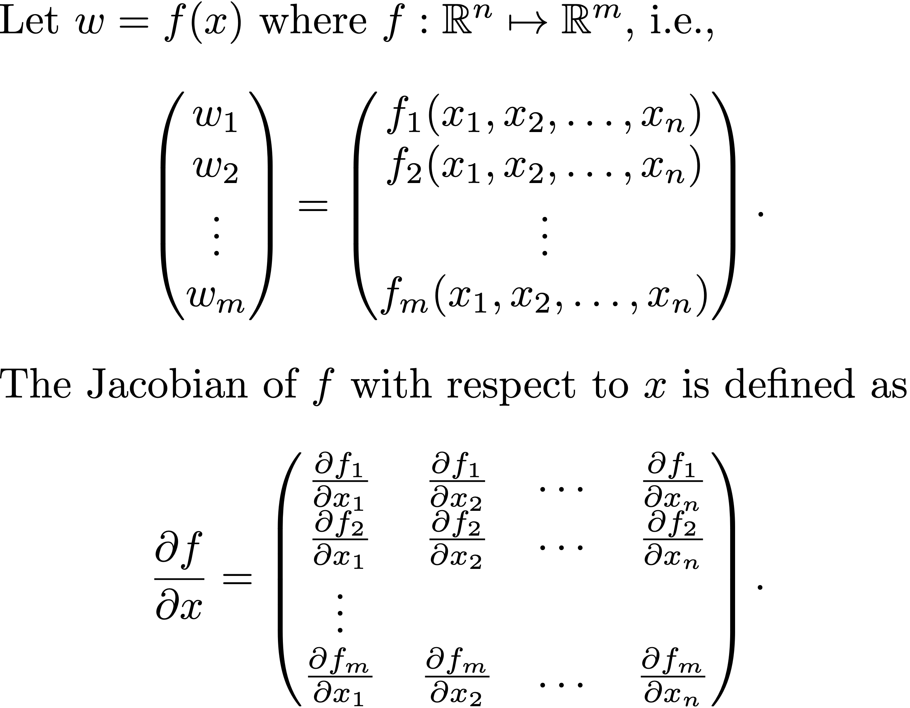
Numerical Computation of State Space Equations
Notes:
\noindent Let $w=f(x)$ where $f:\mathbb{R}^n\mapsto\mathbb{R}^m$, i.e.,
\[
\begin{pmatrix} w_1 \\ w_2 \\ \vdots \\ w_m\end{pmatrix} = \begin{pmatrix} f_1(x_1, x_2, \dots, x_n) \\ f_2(x_1, x_2, \dots, x_n) \\ \vdots \\ f_m(x_1, x_2, \dots, x_n) \end{pmatrix}.
\]
The Jacobian of $f$ with respect to $x$ is defined as
\[
\frac{\partial f}{\partial x} = \begin{pmatrix}
\frac{\partial f_1}{\partial x_1} & \frac{\partial f_1}{\partial x_2} & \dots & \frac{\partial f_1}{\partial x_n} \\
\frac{\partial f_2}{\partial x_1} & \frac{\partial f_2}{\partial x_2} & \dots & \frac{\partial f_2}{\partial x_n} \\
\vdots \\
\frac{\partial f_m}{\partial x_1} & \frac{\partial f_m}{\partial x_2} & \dots & \frac{\partial f_m}{\partial x_n}
\end{pmatrix}.
\]

Slide 48
Numerical Computation of State Space Equations
Notes:
\noindent Let
\[
\frac{\partial f}{\partial x} = \begin{pmatrix}
\frac{\partial f}{\partial x_1} & \frac{\partial f}{\partial x_2} & \dots & \frac{\partial f}{\partial x_n}
\end{pmatrix},
\qquad \text{where} \qquad
\frac{\partial f}{\partial x_i} = \begin{pmatrix}
\frac{\partial f_1}{\partial x_i} \\
\frac{\partial f_2}{\partial x_i} \\
\vdots \\
\frac{\partial f_n}{\partial x_i}
\end{pmatrix}.
\]
If $\epsilon$ is a small fixed number, then
\[
\frac{\partial f}{\partial x_i}(x) \approx \frac{f(x+\epsilon e_i) - f(x)}{\epsilon},
\]
which can be computed numerically, with two calls of $f(\cdot)$.
\vspace{0.5cm}
\noindent Note that computing $\frac{\partial f}{\partial x}(x)$ will require $n+1$ functions calls to $f(\cdot)$.

Slide 49
Numerical Computation of State Space Equations
Notes:
\lstset{language=Python}
\begin{lstlisting}
import numpy as np
def df_dx(x, z):
# take partial of f(x, z) with respect to x
eps = 0.001 # deviation
A = np.zeros((m, n)) # Jacobian of f wrt x
f_at_x = f(x,z)
for i in range(0, n):
x_eps = np.copy(x)
x_eps[i][0] += eps # add eps to ith state
f_at_x_eps = f(x_eps, z)
df_dxi = (f_at_x_eps - f_at_x) / eps
A[:,i] = df_dxi[:,0]
return A
\end{lstlisting}

Slide 50
Numerical Computation of State Space Equations
Notes:
\noindent Define:
\begin{align*}
\text{The Euler state:~} & x_e=(p_n, p_e, p_d, u, v, w, \phi, \theta, \psi, p, q, r)^\top \in\mathbb{R}^{12} \\
\text{The Quaternion state:~} & x_q=(p_n, p_e, p_d, u, v, w, e_0, e_x, e_y, e_z, p, q, r)^\top \in\mathbb{R}^{13}
\end{align*}
Let
\begin{align*}
\mathbf{p} &= (p_n, p_e, p_d)^\top \\
\mathbf{v} &= (u, v, w)^\top \\
\boldsymbol{\vartheta} &= (\phi, \theta, \psi)^\top \\
\mathbf{q} &= (e_0, e_1, e_2, e_3)^\top \\
\boldsymbol{\omega} &= (p, q, r)^\top,
\end{align*}
Then
\begin{align*}
x_e &= (\mathbf{p}^\top, \mathbf{v}^\top, \boldsymbol{\vartheta}^\top, \boldsymbol{\omega}^\top)^\top \\
x_q &= (\mathbf{p}^\top, \mathbf{v}^\top, \mathbf{q}^\top, \boldsymbol{\omega}^\top)^\top.
\end{align*}

Slide 51
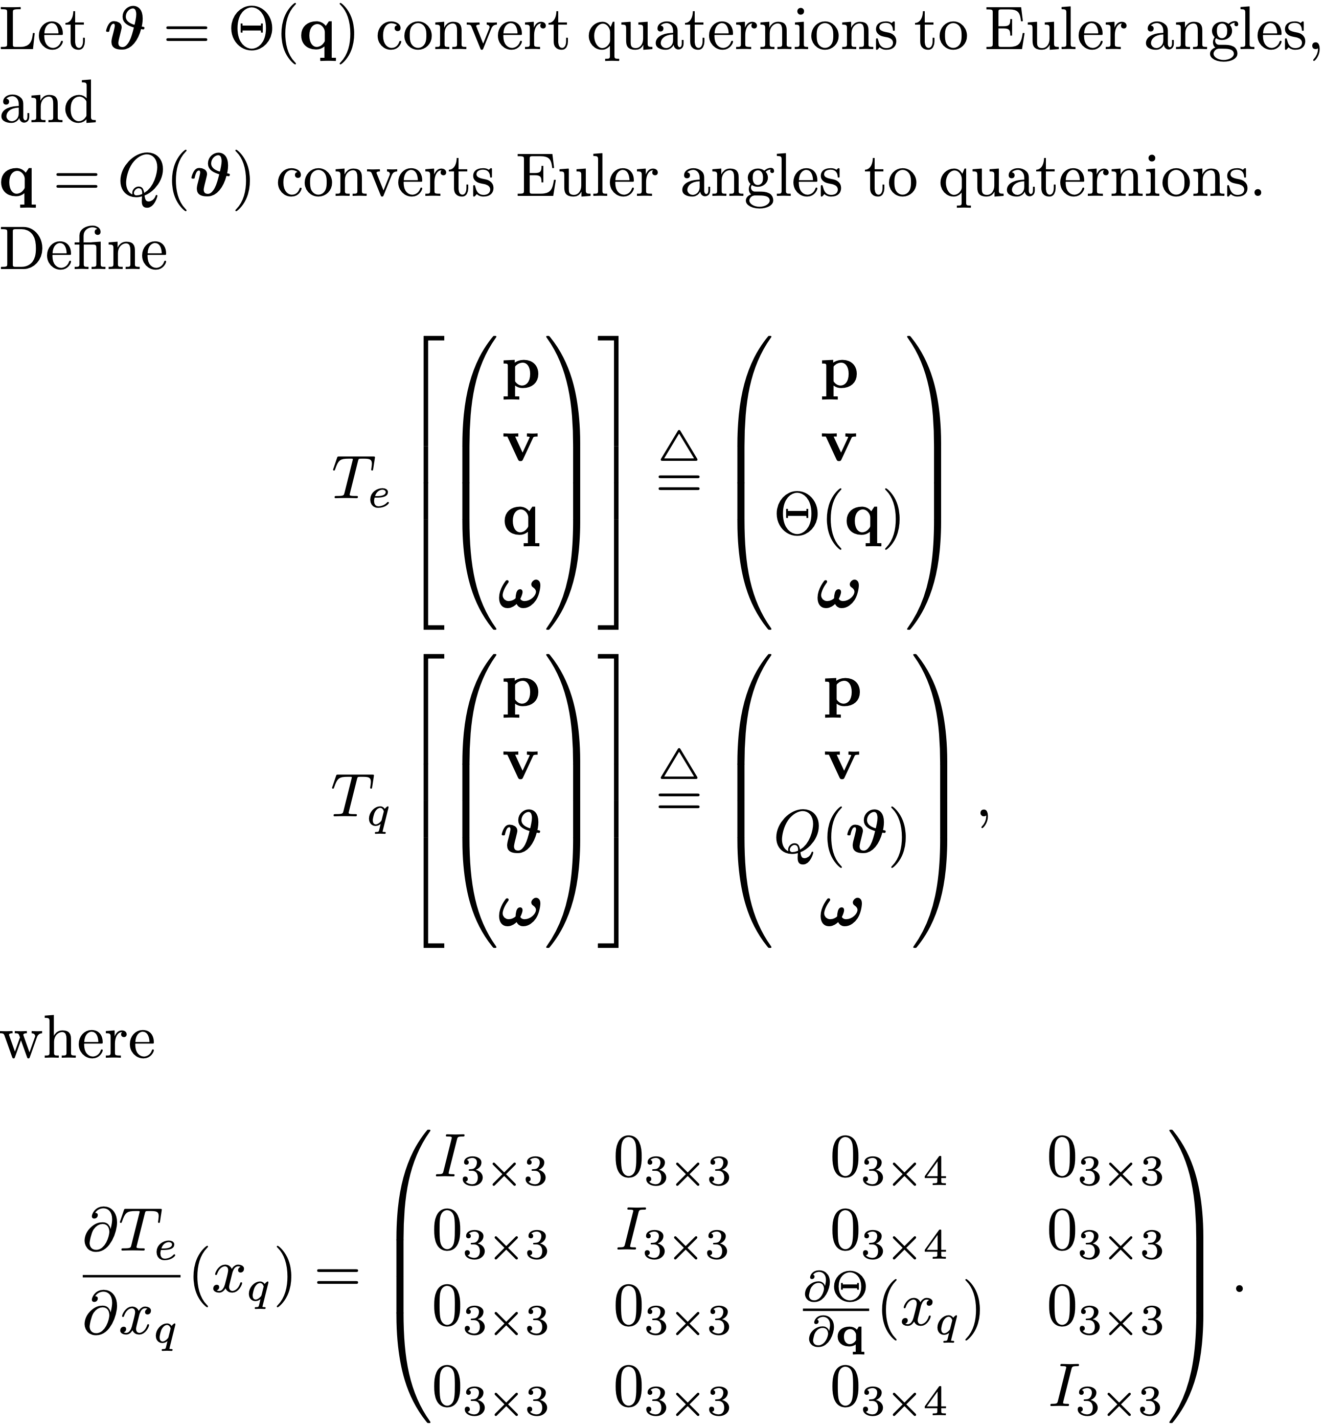
Numerical Computation of State Space Equations
Notes:
Let $\boldsymbol{\vartheta} = \Theta(\mathbf{q})$ convert quaternions to Euler angles, and
$\mathbf{q}=Q(\boldsymbol{\vartheta})$ converts Euler angles to quaternions.
Define
\begin{align*}
T_e \left[\begin{pmatrix}\mathbf{p} \\ \mathbf{v} \\ \mathbf{q} \\ \boldsymbol{\omega} \end{pmatrix}\right] &\defeq \begin{pmatrix} \mathbf{p} \\ \mathbf{v} \\ \Theta(\mathbf{q}) \\ \boldsymbol{\omega} \end{pmatrix} \\
T_q\left[\begin{pmatrix}\mathbf{p} \\ \mathbf{v} \\ \boldsymbol{\vartheta} \\ \boldsymbol{\omega} \end{pmatrix}\right] &\defeq \begin{pmatrix}\mathbf{p} \\ \mathbf{v} \\ Q(\boldsymbol{\vartheta}) \\ \boldsymbol{\omega} \end{pmatrix},
\end{align*}
where
\begin{align*}
\frac{\partial T_e}{\partial x_q}(x_q) &= \begin{pmatrix}
I_{3\times 3} & 0_{3\times 3} & 0_{3\times 4} & 0_{3\times 3} \\
0_{3\times 3} & I_{3\times 3} & 0_{3\times 4} & 0_{3\times 3} \\
0_{3\times 3} & 0_{3\times 3} & \frac{\partial \Theta}{\partial \mathbf{q}}(x_q) & 0_{3\times 3} \\
0_{3\times 3} & 0_{3\times 3} & 0_{3\times 4} & I_{3\times 3}
\end{pmatrix}.
\end{align*}

Slide 52
Numerical Computation of State Space Equations
Notes:
\noindent The Python dynamics file returns:
\[
\dot{x}_q = f_q(x_q, u).
\]
In terms of Euler states we have:
\begin{align*}
\dot{x}_e
&= \frac{d}{dt}T_e(x_q)
= \frac{\partial T_e}{\partial x_q}(x_q) \dot{x}_q
= \frac{\partial T_e}{\partial x_q}(x_q) f_q( x_q, u) \\
&= \frac{\partial T_e}{\partial x_q}(T_q(x_e)) f_q( T_q(x_e), u) ).
\end{align*}
If $\tilde{x}_e = x_e - x_e^\ast$, $\tilde{u} = u-u^\ast$,
the state space equations are
\[
\dot{\tilde{x}}_e = A \tilde{x}_e + B \tilde{u},
\]
where
\begin{align*}
A &= \frac{\partial}{\partial x_e} \left(\frac{\partial T_e}{\partial x_q}(T_q(x_e)) f_q( T_q(x_e), u) )\right) \\
B &= \frac{\partial}{\partial u} \left(\frac{\partial T_e}{\partial x_q}(T_q(x_e)) f_q( T_q(x_e), u) )\right).
\end{align*}

Slide 53
Longitudinal State Space Equations
Notes:
\noindent The longitudinal states and inputs are
\setcounter{MaxMatrixCols}{12}
\begin{align*}
x_{lon} &= \begin{pmatrix} u \\ w \\ q \\ \theta \\ h \end{pmatrix}
= \begin{pmatrix}
0 & 0 & 0 & 1 & 0 & 0 & 0 & 0 & 0 & 0 & 0 & 0 \\
0 & 0 & 0 & 0 & 0 & 1 & 0 & 0 & 0 & 0 & 0 & 0 \\
0 & 0 & 0 & 0 & 0 & 0 & 0 & 0 & 0 & 0 & 1 & 0 \\
0 & 0 & 0 & 0 & 0 & 0 & 0 & 1 & 0 & 0 & 0 & 0 \\
0 & 0 & -1 & 0 & 0 & 0 & 0 & 0 & 0 & 0 & 0 & 0
\end{pmatrix} \begin{pmatrix} p_n \\ p_e \\ p_d \\ u \\ v \\ w \\ \phi \\ \theta \\ \psi \\ p \\ q \\ r \end{pmatrix} \defeq E_1 x_e \\
u_{lon} &= \begin{pmatrix} \delta_e \\ \delta_t \end{pmatrix}
= \begin{pmatrix}
0 & 1 & 0 & 0 \\
1 & 0 & 0 & 0 \end{pmatrix}
\begin{pmatrix}
\delta_t \\ \delta_e \\ \delta_a \\ \delta_r
\end{pmatrix} \defeq E_2 u.
\end{align*}
Therefore the longitudinal state space equations are
\[
\dot{x}_{lon} = A_{lon}x_{lon} + B_{lon} u_{lon}
\]
where
\begin{align*}
A_{lon} &= E_1 A E_1^\top \\
B_{lon} &= E_1 B E_2^\top.
\end{align*}

Slide 54
Lateral State Space Equations
Notes:
\noindent The lateral states and inputs are
\setcounter{MaxMatrixCols}{12}
\begin{align*}
x_{lat} &= \begin{pmatrix} v \\ p \\ r \\ \phi \\ \psi \end{pmatrix}
= \begin{pmatrix}
0 & 0 & 0 & 0 & 1 & 0 & 0 & 0 & 0 & 0 & 0 & 0 \\
0 & 0 & 0 & 0 & 0 & 0 & 0 & 0 & 0 & 1 & 0 & 0 \\
0 & 0 & 0 & 0 & 0 & 0 & 0 & 0 & 0 & 0 & 0 & 1 \\
0 & 0 & 0 & 0 & 0 & 0 & 1 & 0 & 0 & 0 & 0 & 0 \\
0 & 0 & 0 & 0 & 0 & 0 & 0 & 0 & 1 & 0 & 0 & 0
\end{pmatrix}
\begin{pmatrix} p_n \\ p_e \\ p_d \\ u \\ v \\ w \\ \phi \\ \theta \\ \psi \\ p \\ q \\ r \end{pmatrix} \defeq E_3 x_e \\
u_{lat} &= \begin{pmatrix} \delta_a \\ \delta_r \end{pmatrix}
= \begin{pmatrix}
0 & 0 & 1 & 0 \\
0 & 0 & 0 & 1 \end{pmatrix}
\begin{pmatrix}
\delta_t \\ \delta_e \\ \delta_a \\ \delta_r
\end{pmatrix} \defeq E_4 u,
\end{align*}
Therefore the lateral state space equations are
\[
\dot{x}_{lat} = A_{lat}x_{lat} + B_{lat} u_{lat}
\]
where
\begin{align*}
A_{lat} &= E_3 A E_3^\top \\
B_{lat} &= E_3 B E_4^\top.
\end{align*}

Slide 55
Reduced Order Modes
Longitudinal Modes
Short-period Mode
Short-period mode is the fast mode seen in pitch rate q and pitch angle
Phugoid Mode
Phugoid mode is slow mode seen in pitch angle and u
Induced by impulse on elevator
Lateral Modes
Roll Mode
First order fast mode between aileron and roll rate
Spiral-divergence Mode
First order (really) slow mode between aileron and yaw/course
Dutch-roll Mode
Second order mode: coupling between roll, yaw, and side slip. Like a duck wagging its tail
Induced by doublet on aileron or rudder

Slide 56
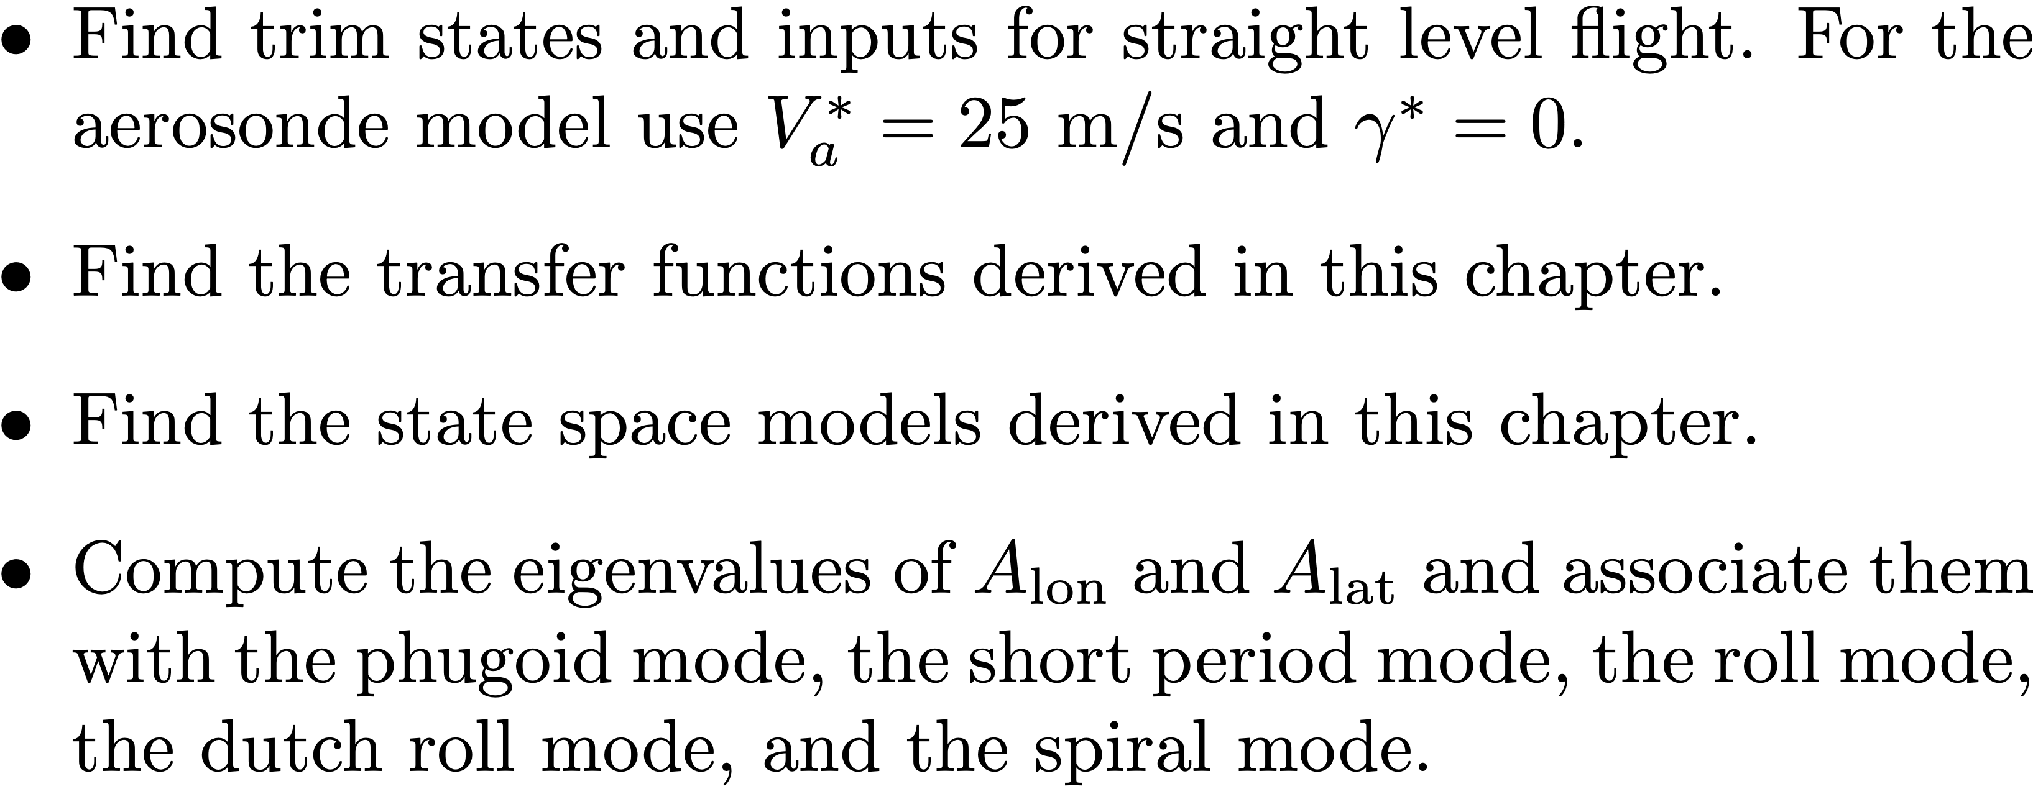
Simulation Project
Notes:
\begin{itemize}
\item Find trim states and inputs for straight level flight. For the aerosonde model use $V_a^\ast=25$~m/s and $\gamma^\ast=0$.
\item Find the transfer functions derived in this chapter.
\item Find the state space models derived in this chapter.
\item Compute the eigenvalues of $A_{\text{lon}}$ and $A_{\text{lat}}$ and associate them with the phugoid mode, the short period mode, the roll mode, the dutch roll mode, and the spiral mode.
\end{itemize}

